Slide 1
Computer Vision (CV)
[RCNN Family]

Slide 2
R-CNN for object detection
• Scan the input image for possible objects using an algorithm called Selective Search, enerating ~2000 region proposals.
• Run a convolutional neural net (CNN) on top of each of these region proposals.
• Take the output of each CNN and feed it into
SVM to classify the region
Linear regressor to tighten the bounding box of the object if such an object exists.

Slide 3
Selective Search Algorithm
Initial Segmentation: Over-segments the image into thousands of tiny, initial starter regions.
Similarity Calculation: Measures how alike adjacent regions are based on color, texture, size, and shape fit.
Iterative Merging: Continually merges the two most similar neighboring regions into a larger one.
Hierarchical Grouping: Repeats this merging process from the bottom up until the entire image is a single region.
Proposal Generation: Draws bounding boxes around every region created during the process, resulting in the ~2000 region proposals

Slide 4
R-CNN Architecture

Slide 5
Fast R-CNN
• The purpose of the Fast Region-based Convolutional Network (Fast R-CNN) is to reduce the time consumption related to the high number of models necessary to analyze all region proposals.
• Performing feature extraction over the image before proposing regions, thus only running one CNN over the entire image instead of 2000 CNN’s over 2000 overlapping regions.
• Replacing the SVM with a softmax layer, thus extending the neural network for predictions instead of creating a new model.

Slide 6
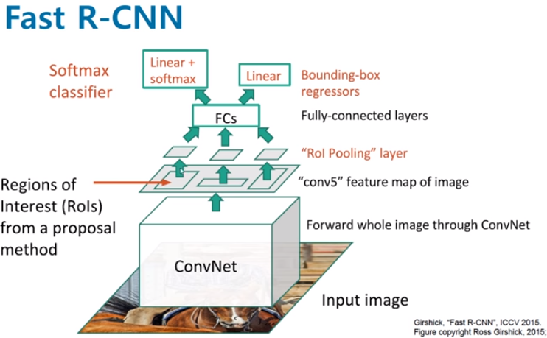
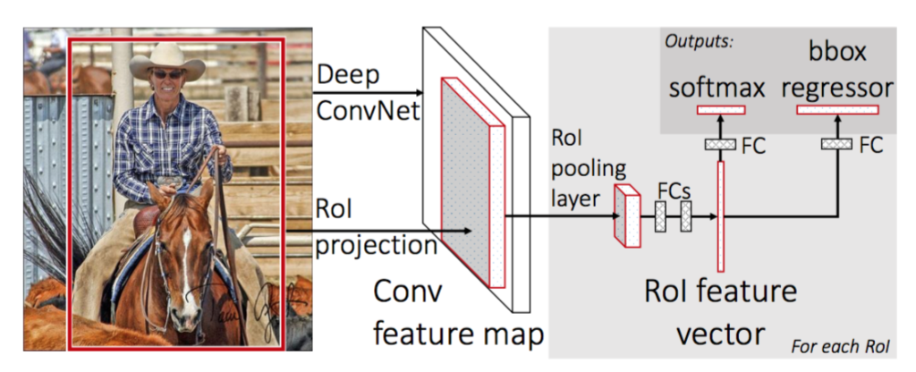
Fast R-CNN Architecture

Slide 7
Faster R-CNN
• Step 1: Feature Extraction
The input image is passed through a pre-trained CNN backbone (the original Faster R-CNN used VGG).
The network extracts a convolutional feature map, which is then used for subsequent processing.
• Step 2: Region Proposal Network (RPN)
The RPN takes the feature map and proposes a set of candidate regions (bounding boxes) that may contain objects.
It does this by generating multiple region proposals using k anchor boxes of predefined scales and aspect ratios.
k anchor boxes = the number of predefined bounding box shapes (scales + ratios) that the network uses at each feature map location to generate region proposals.
Each anchor = one rectangle shape.
You choose different scales (small, medium, large)And different aspect ratios (e.g., 1:1, 2:1, 1:2) This module significantly speeds up both training and inference compared to earlier methods.
• Step 3: R-CNN Module
For each proposed region, the R-CNN head performs two tasks:
Classification – Determine what object (if any) is inside the region, including the “background” category.
Bounding Box Regression – Refine the bounding box coordinates to better align with the detected object.

Slide 8
How RPN Detects Objects (Anchor Box Labeling)
Intersection over Union (IoU): Measures the overlap between the Anchor Box and the Ground Truth (true object box).
Positive Anchors (Object): Boxes with high IoU (e.g., > 0.7) are labeled as containing an object.
Negative Anchors (Background): Boxes with low IoU (e.g., < 0.3) are labeled as background.
RPN Classification Head: Outputs a probability score for each anchor box p_object vs. p_background to filter out empty regions.
Bounding Box Regression: Automatically adjusts the coordinates of the chosen anchor box to tightly fit the object.

Slide 9
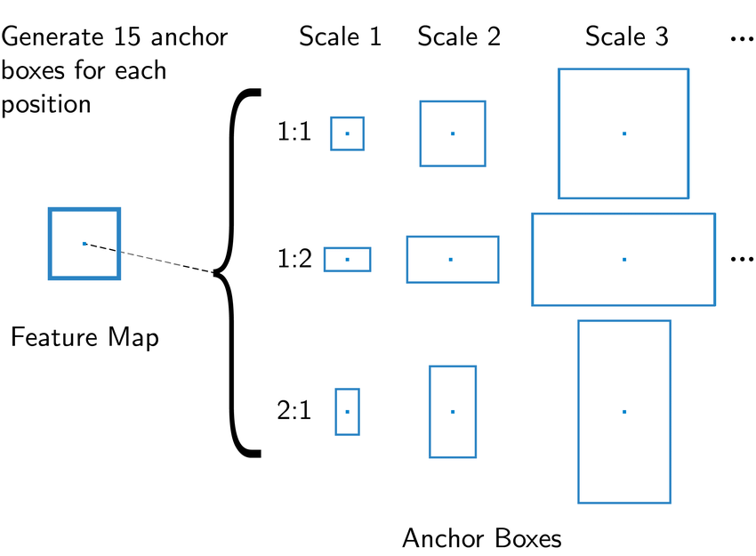
illustration

Slide 10
Mask RCNN

Slide 11
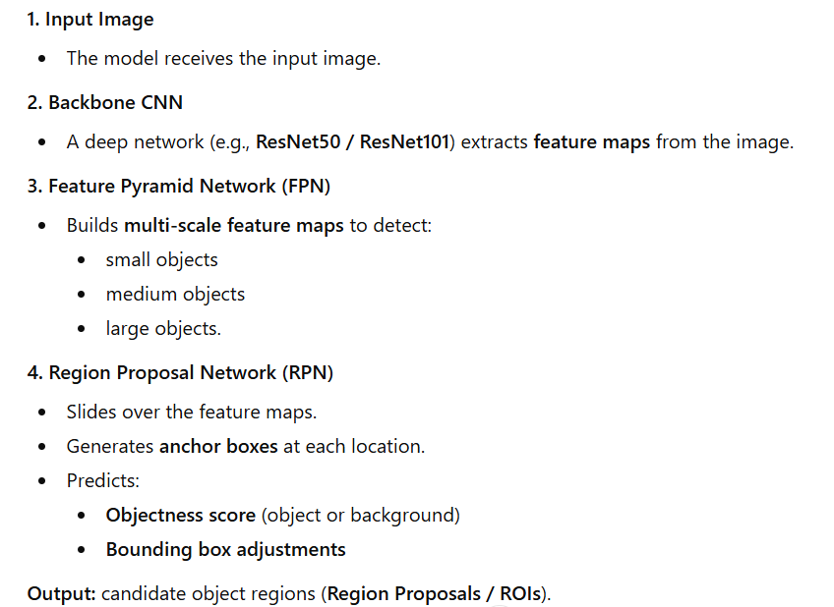
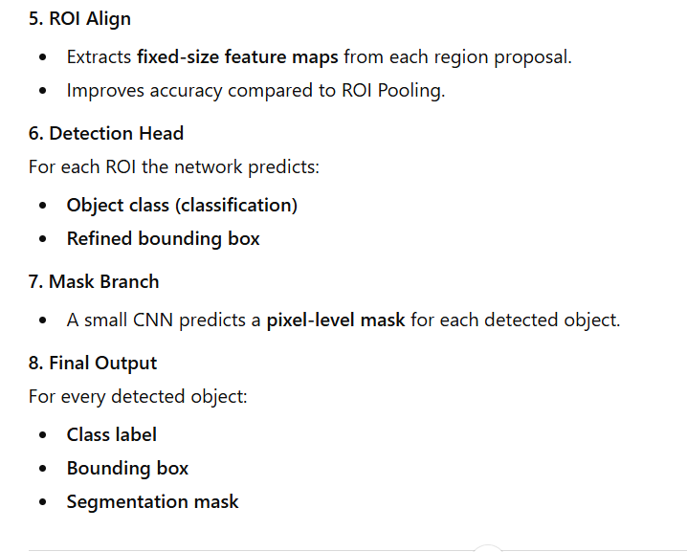
Steps of Mask RCNN

Slide 12
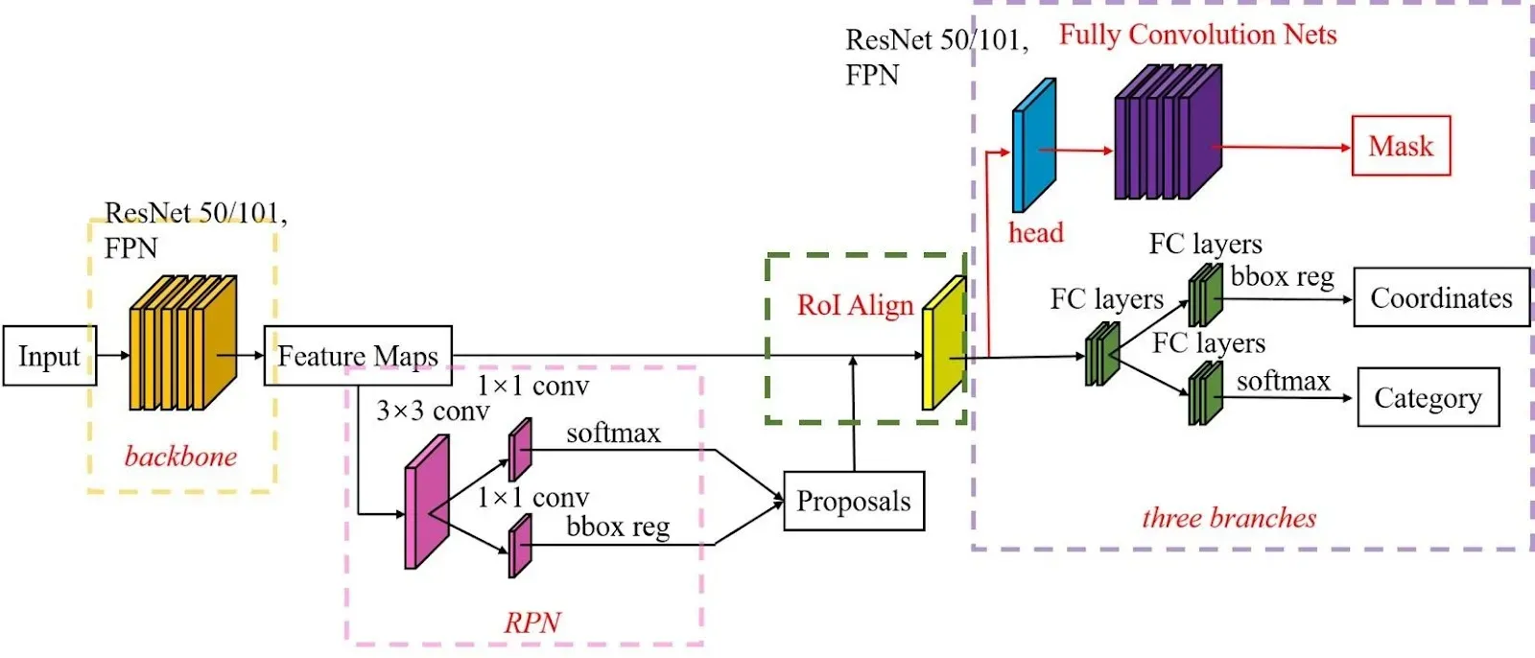
Mask R-CNN Architecture

Slide 13
Detectron2
• Detectron2 was built by Facebook AI Research (FAIR) to support rapid implementation and evaluation of novel computer vision research.
• Detectron2 is now implemented in PyTorch.
• Detectron2 is flexible and extensible, and able to provide fast training on single or multiple GPU servers.
• Detectron2 can be used as a library to support different projects on top of it.

Slide 14
Detectron2 Model Zoo
Detectron2 Model Zoo : https://github.com/facebookresearch/detectron2/blob/master/MODEL_ZOO.md

Slide 15
Detectron2 - Inference

Slide 16
Train Detectron2 On A Custom Dataset
Convert your data-set to COCO-format
The COCO dataset is formatted in JSON and has five annotation types: object detection, keypoint detection, stuff segmentation, panoptic segmentation, and image captioning. It is a collection of “info”, “licenses”, “images”, “annotations”, “categories” (in most cases), and “segment info” (in one case).

Slide 17
